Slide 1

Design Thinking and Innovation
TITLE PAGE
Problem Statement Title-
Theme-
PS Category- Software/Hardware
Team Name

Slide 2

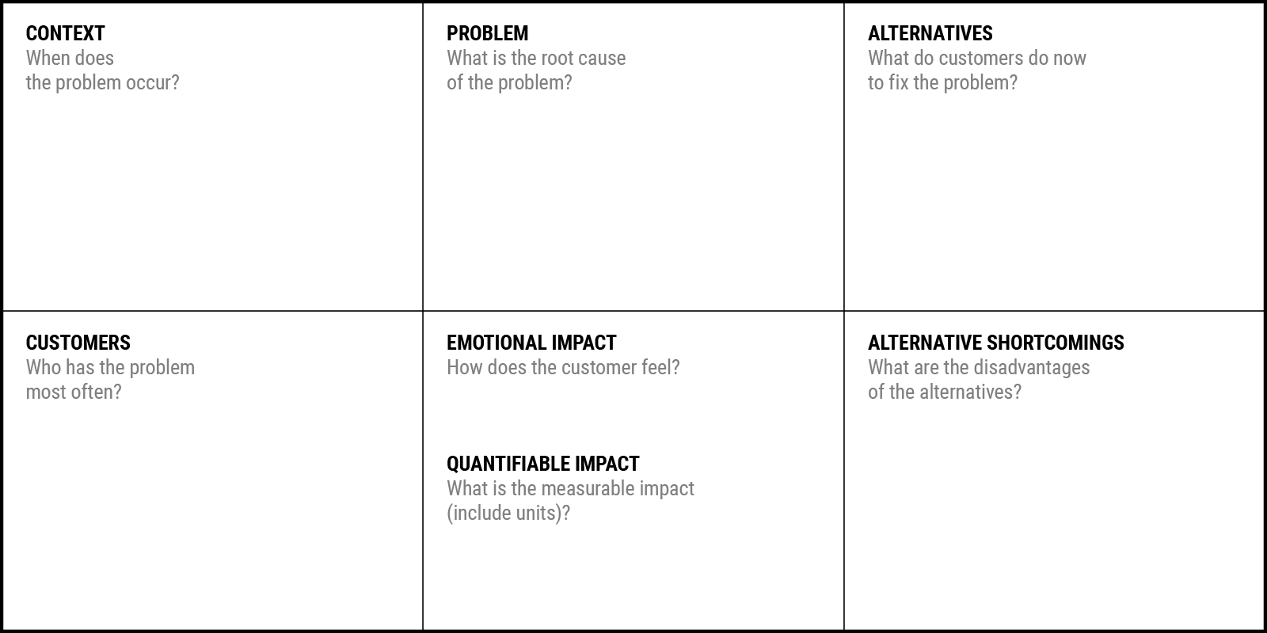
IDEA TITLE
Problem Statement Canvas
YUKTI Proto ID:
Idea/Innovation Title:
Your Team Name
Date of Submission:
Who is your Customer Segment:
Prepared By:
Contact No:
Your Answer:
Your Answer:
Your Answer:
Problem Statement(Empathy)
Detailed explanation of the proposed solution
How it addresses the problem
Innovation and uniqueness of the solution
Your Answer:
Your Answer:
Your Answer:
Your Answer:

Slide 3
IDEA TITLE
Your Team Name
Proposed Solution (Describe your Idea/Solution/Prototype)
Detailed explanation of the proposed solution
Objectivies
How it addresses the problem
Innovation and uniqueness of the solution

Slide 4
TECHNICAL APPROACH
Your Team Name
Technologies to be used (e.g. programming languages, frameworks, hardware)
Methodology and process for implementation (Flow Charts/Images/ working prototype)

Slide 5
FEASIBILITY AND VIABILITY
Your Team Name
Analysis of the feasibility of the idea
Potential challenges and risks
Strategies for overcoming these challenges

Slide 6
IMPACT AND BENEFITS
Your Team Name
Potential impact on the target audience
Benefits of the solution (social, economic, environmental, etc.)
SDG Goals addressed

Slide 7
RESEARCH AND REFERENCES
Your Team Name
Details / Links of the reference and research work

